Slide 1
Parallelized Davis-Putnam
Matthew Holmes

Slide 2
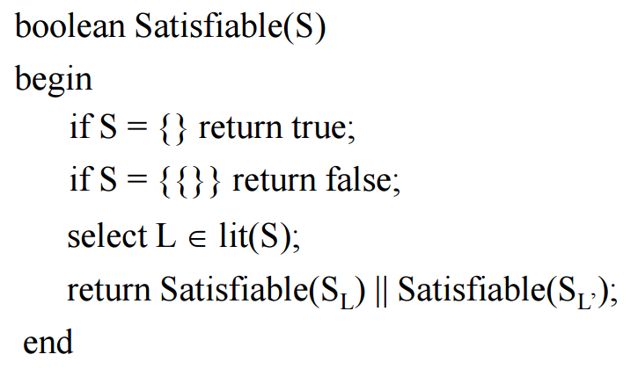
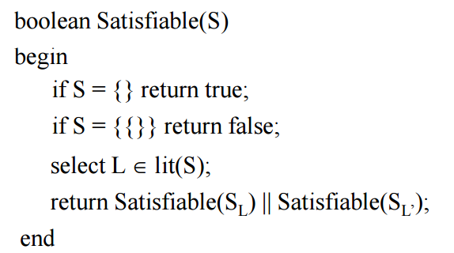
Davis Putnam

Slide 3
Parallel
OpenMP
Open Multi-Processing
multi-platform shared memory multiprocessing
CUDA/Thrust
Compute Unified Device Architecture
Created by NVIDIA
Works on the GPU
SIMT (Single Instruction Multiple Thread) execution
Thrust
Resembles the C++ Standard Template Library

Slide 4
Project Goals
Parallelize the Davis-Putnam algorithm
Attempt to maximize worst case time
Analyze the effectiveness

Slide 5
Omissions
Many improvements, most notably things like subsumption
Only looking at worst case
Intelligent parser
Easier to generate and work with large datasets

Slide 6
Simple case
{!A, B, C}, {!B}, {A}, {!C}
Serial Average Runtime: 0ms
Less than a ms so rounded down
OpenMP Average Runtime: 1.8ms
CUDA Average Runtime: 1.99ms
Nothing really shocking, for most use cases serial works just fine

Slide 7
Large Invalid Sets
Generation:
Without subsumption, the worst-case is very easy to create:
{x₀, x₁, …, x_{n}}
{x₀, x₁, …, x_{n-1}}
I ran two tests using this type of data:
n=10,000,000
n=100,000,000

Slide 8
Large Set Results
n=10,000,000
Serial Average Runtime: 195.8ms
OpenMP Average Runtime: 157.3ms (~125% speedup)
CUDA Average Runtime: 34.6ms (~500% speedup!!)
n=100,000,000
Serial Average Runtime: 1911.7ms
OpenMP Average Runtime: 1426.18ms
CUDA Average Runtime: 293.45ms

Slide 9
Larger Valid Set
Next, to ensure that I still get the correct result on a larger set I generated a Valid argument with n = 1000 as follows
{x₀, x₁, …, x_{n}}
{!x₀}
{!x₁}
…
{!x_{n}}

Slide 10
Large Valid Results
Serial Average Runtime: 887.2ms
OpenMP Average Runtime: 1355.8ms
CUDA Average Runtime: 276.1ms
Pretty poor performance, likely due to the amount of sets in use

Slide 11
Many Sets
Unsurprisingly, creating a large number of sets in worst case is also fairly straightforward
{x₀}
{x₁}
…
{x_{n}}
In my uses, n = 5000
Tuned due to TERRIBLE runtime

Slide 12
Many Set Results
Serial Average Runtime: 20971.6ms
OpenMP Average Runtime: 25989.2ms
CUDA Average Runtime: Out of Memory!
Still not really happy with any of their performances… If more work would be done it would be done here

Slide 13
Iteration Graph

Slide 14
Thank You
Any Questions?

